Slide 1
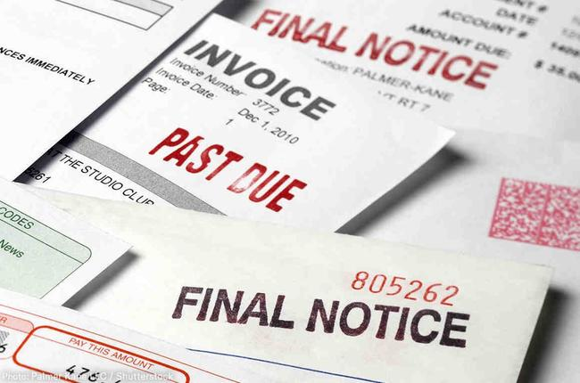

KAPE
Peer to Peer Lending Platform
Joseph Kuitche, Manuela Nkwinkwa
Notes:
For our first project we chose to work on a peer-to-peer lending application.

Slide 2

INTRODUCTION: KAPE
Connecting Investors and Borrowers
How it works
Code oversight
Notes:
Kape is a peer to peer lending application that allows individual to bypass financial institutions and have direct access to loans opportunities. This help on one side individual with a need of money deficit and that would not qualify through traditional channels to have access to funds at reasonable interest rates. On The other side, it provide opportunities for individuals in excess of money to be able to invest and have a return on their investments at rates higher than if the money was simply sitting in a savings account.

Slide 3

Part 1-Investor: lender.ipynd
Part 2- Borrower: borrower.ipynb
This Photo by Unknown Author is licensed under CC BY-SA
Notes:
The purpose of this project is to help people who need money (borrowers) and those who have money (investors) in their decision making.
This project has two parts:
The first part, lender.ipynb, analyzes the loan data from investor standpoint;
and the second part, borrower.ipynb, analyzes aid data from a borrower standpoint.

Slide 4

LENDERS FEATURES
Expected Returns
Default Risks
Recommendation (Should you invest?)
This Photo by Unknown Author is licensed under CC BY-NC
Notes:
Lenders are interested in maximizing their profits while minimizing their risks. Based on the dataset, we determine default risks associated with loans as well as returns investors should expect for their investments. We provide recommendation as to wheter lending to a particular individual is a sound decision depending on investors level of acceptable risk.

Slide 5

BORROWERS FEATURES
Data used
Risk determination
Fund recomandation (Should you take the loan?)
This Photo by Unknown Author is licensed under CC BY
Notes:
We used 5 different dataset to design a model that would help us predict the risk associated with borrowers defaulting on loans. It also helped us make recommendations to the borrower as whether or not taking the loan is financially sound for them given the requested interest rate required.

Slide 6
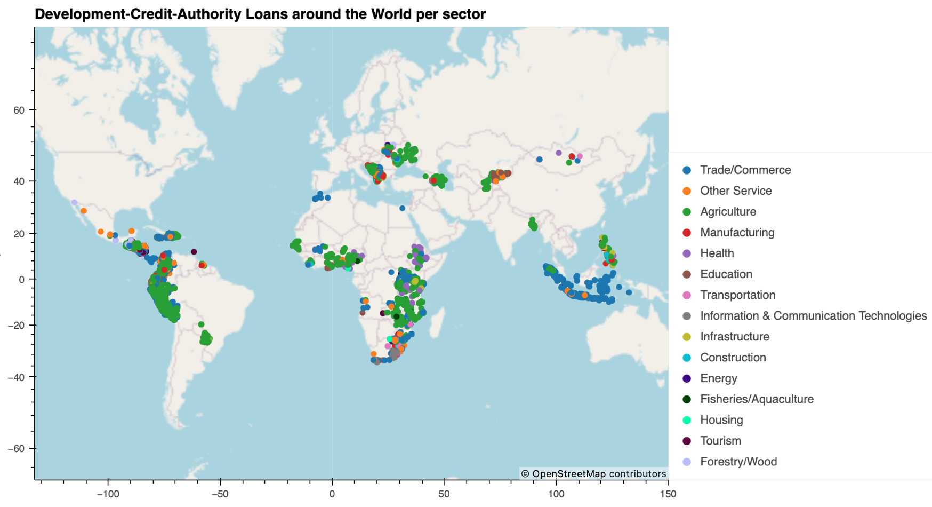
Lending Opportunities Per Business Sectors
Notes:
The need of money is on a global level. Map illustrating geographic location of some borrowers relying on peer-to-peer lending applications

Slide 7
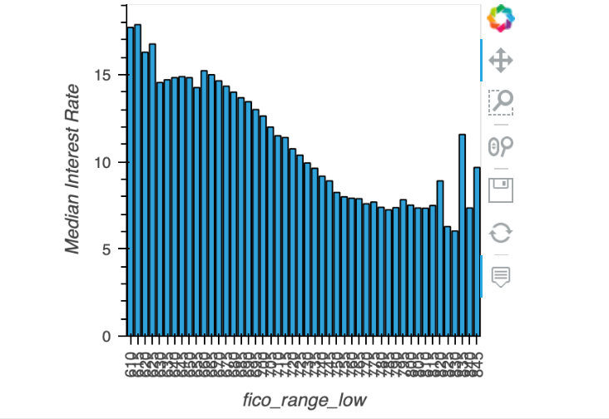
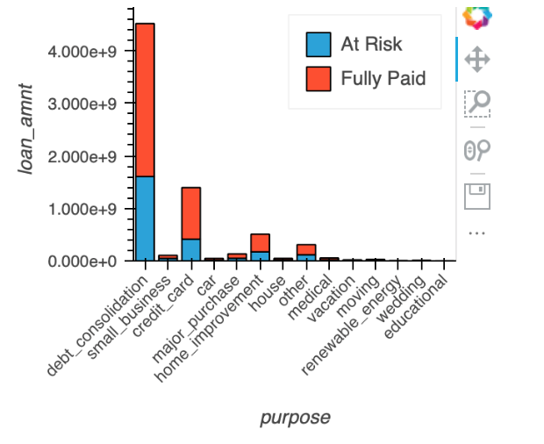
LENDERS RISKS EVALUATION
Risks and loan purpose
Risks and FICO Score

Slide 8
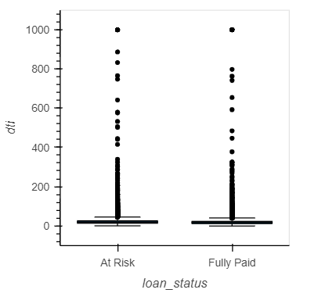
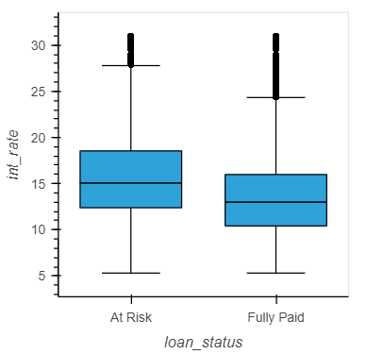
Loan Default
Risks Assesment

Slide 9
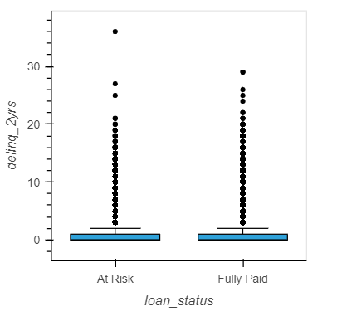
2 years Delinquency Histogram

Slide 10


LIMITATIONS
Data
Model
This Photo by Unknown Author is licensed under CC BY-SA-NC
This Photo by Unknown Author is licensed under CC BY-NC-ND
Notes:
The load of datasets used posed some problems while designing our model. Some Codes would not run due to the size of the dataset causing some frustration but ultimately it was a rewarding experience.

Slide 11





CONCLUSION
Notes:
Kape is a peer-to-peer lending platform that allows Investors and Borrowers to meet. Our code allows to determine attractive features for borrowers and lenders and provide recommendation on whether they should commit to an opportunity or not. Although we faced some limitations, it is safe to say that Kape brings a solution to a real problem which is the distribution of funds from those that have an excess to those that need.

Slide 12
Reference
Siddhartha, M. (2021, July 23). Bondora peer to peer lending loan data. Kaggle. Retrieved April 17, 2023, from https://www.kaggle.com/datasets/sid321axn/bondora-peer-to-peer-lending-loan-data
Devastator, T. (2022, December 14). DCA Loan Dataset. Kaggle. Retrieved April 17, 2023, from https://www.kaggle.com/datasets/thedevastator/unlock-financing-through-usaid-dca-loan-transact

Slide 13

Thank You!
Questions?

